Slide 1
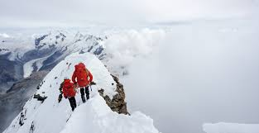

Jamia Hamdard
Mountaineering and Trekking Club
Activities:
Long walks
Heritage walks
Trekking
Hiking
Training of mountaineering
In collaboration with Indian Mountaineering Federation
Click to register:
Adventure calling!!

